Slide 1
Narrative Writing
Rewriting the Introduction
© Copyright by Write Score LLC

Slide 2
Narrative Writing Standard
Write narratives to develop real or imagined experiences or events using effective technique, relevant descriptive details, and well structured event sequences.

Slide 3
Three Types of Narrative Prompts:
REWRITE THE BEGINNING
ADD DETAILS/REWRITE A PORTION
REWRITE THE ENDING

Slide 4
Rewrite the Introduction
To rewrite the introduction, the reader may be asked to:
respond from another character’s point of view.
add descriptive language.
change an aspect of the introduction based on what you learned from the rest of the story.

Slide 5
Tips to Consider
When Reading the Prompt:
What part of the text will I rewrite/change?
From whose point of view will I write?
When Reading the Text:
Identify key ideas in the story.
Remember to stay consistent with the storyline.
When Planning to Write:
What do I know about the characters? The setting?
Whose point of view will the response be in?

Slide 6
Narrative Prompt:
The story begins with Emma reflecting on her embarrassment over her hand-me-down violin.
Rewrite the first paragraph from Hannah’s perspective. Be sure to include details that clearly show how Emma’s violin is different than her classmate’s.
Compose your answer in the space provided.

Slide 7
The Hand-Me-Down Violin
by John Keeser
Emma looked at the tattered brown leather case and sighed. The case is embarrassing, she thought, but at least I can replace that. It was the violin inside that looked much worse.
She knew she was fortunate that she had a violin to play in her school strings ensemble, but she couldn’t help but compare this violin with everyone else’s instruments. For instance, Hannah, an eighth grader who was first chair violinist, had a beautiful new violin and a soft padded case that she could wear like a backpack.

Slide 8
Directions
With a partner, read the rest of the story and underline any other details you will need to consider when responding to the prompt.

Slide 9
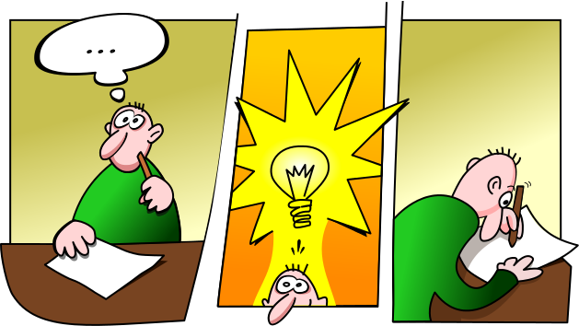
Summarize Your Findings
Choose three pieces of evidence that best help you understand the story from Hannah’s perspective. Add those to the handout. Then, rewrite the introduction in the space provided.

